Slide 2
Case 1 Results

Slide 3
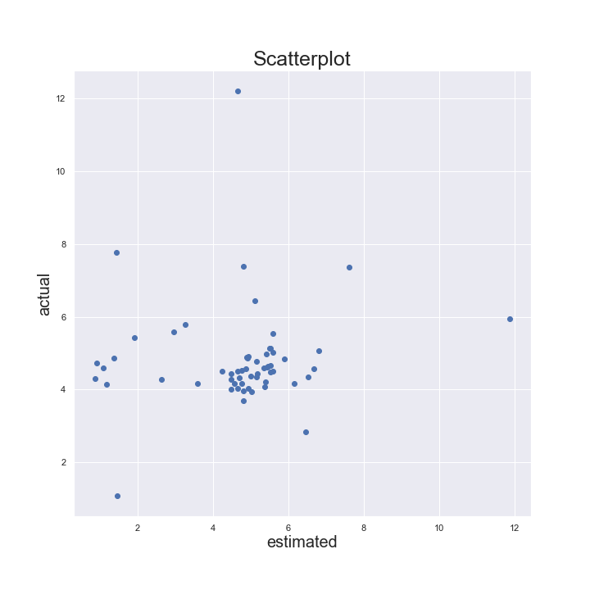
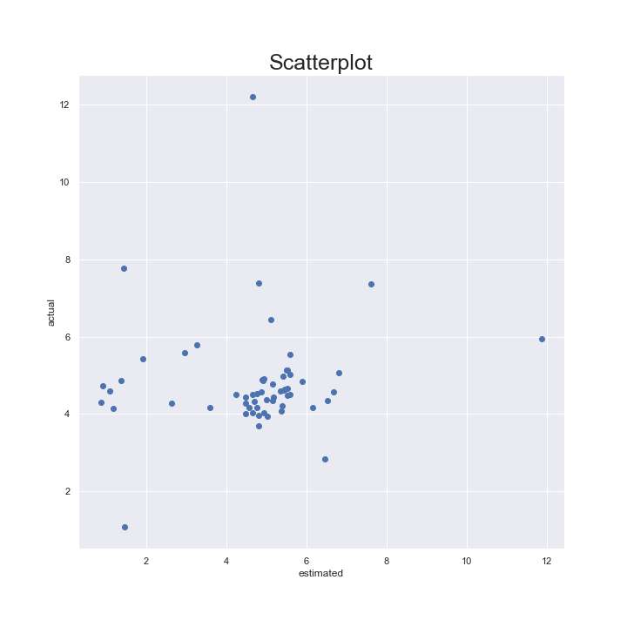

Overview

Slide 4
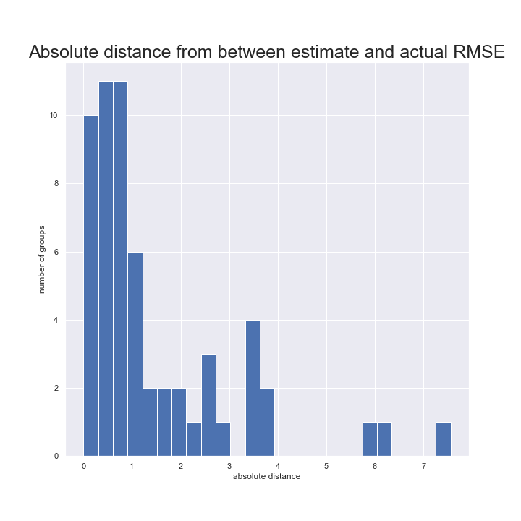
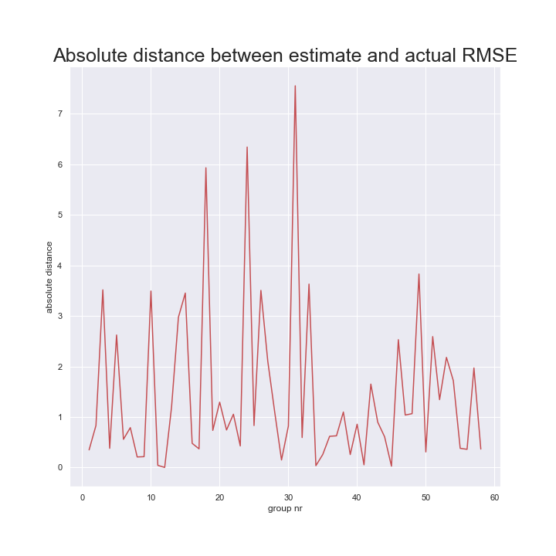

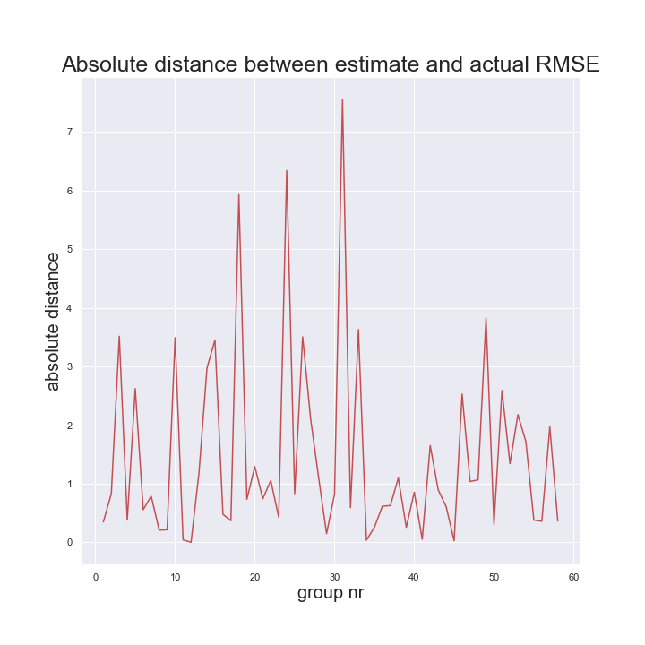
Bias In Estimation

Slide 5
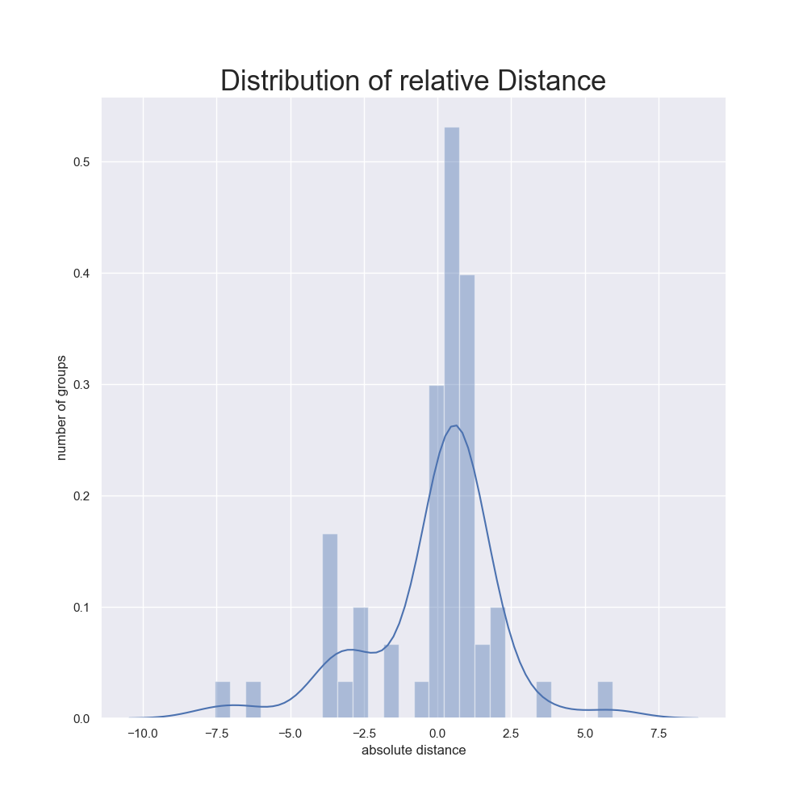
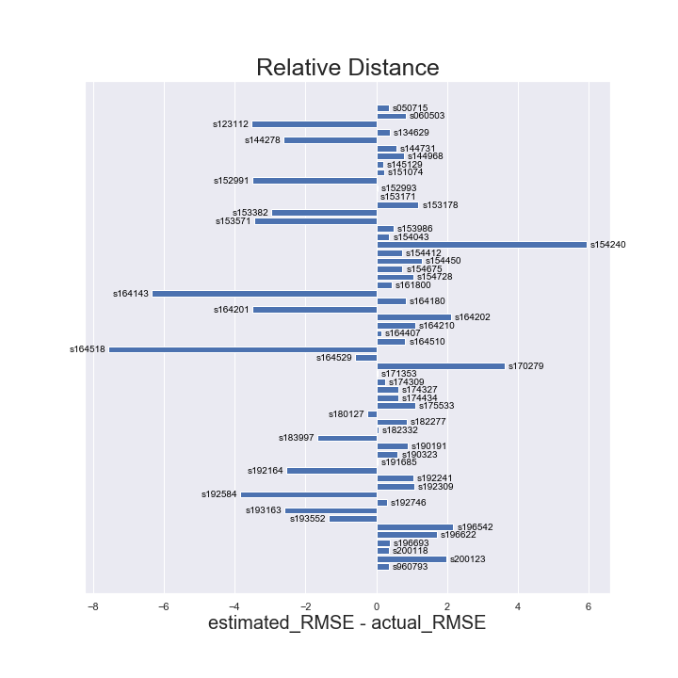
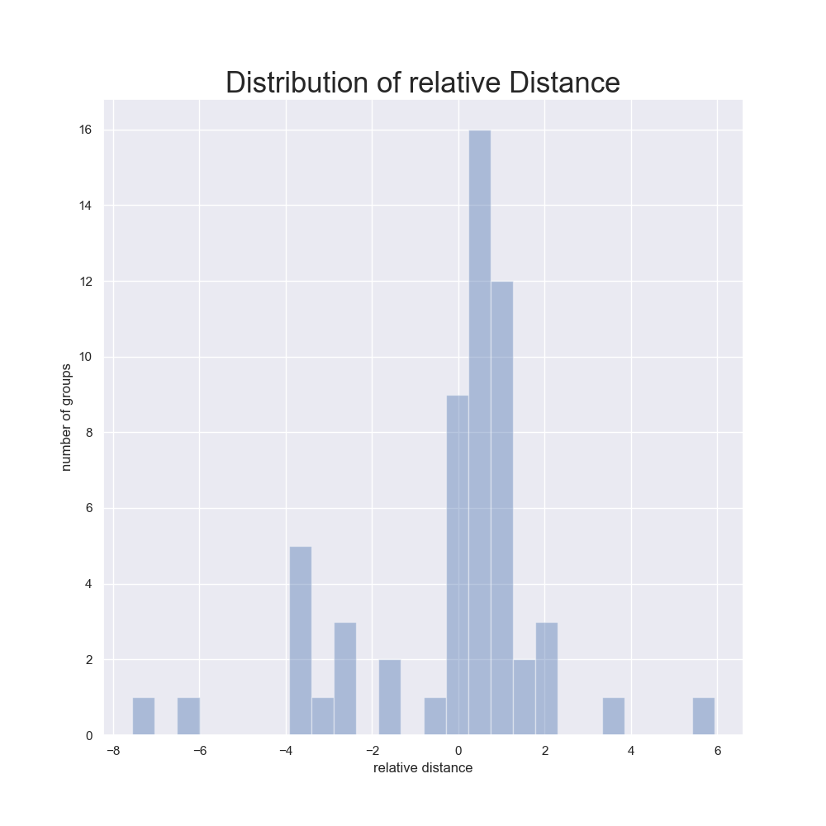
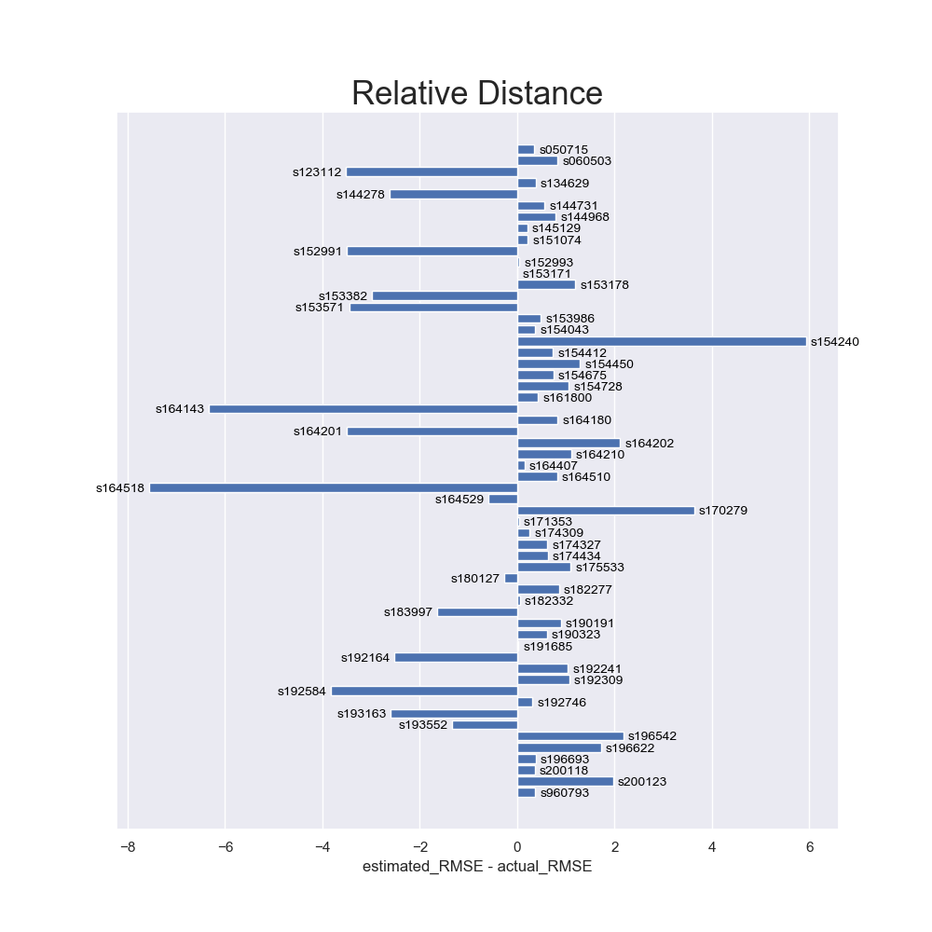
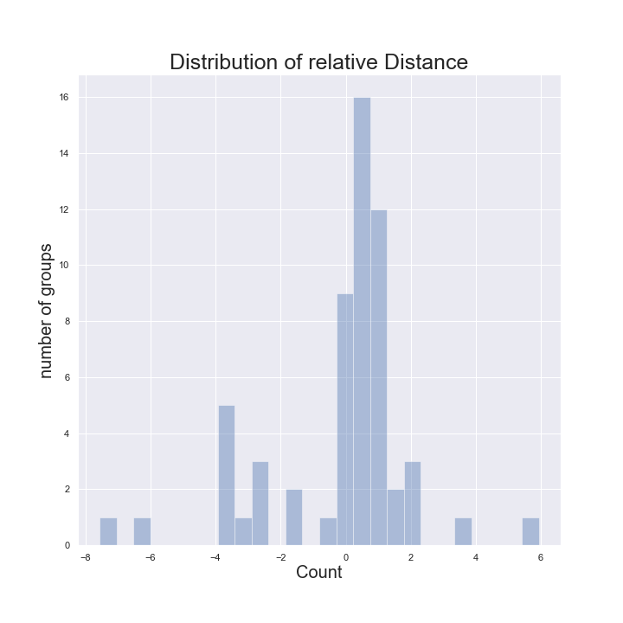
Relative Distance & Model Choice

Slide 6
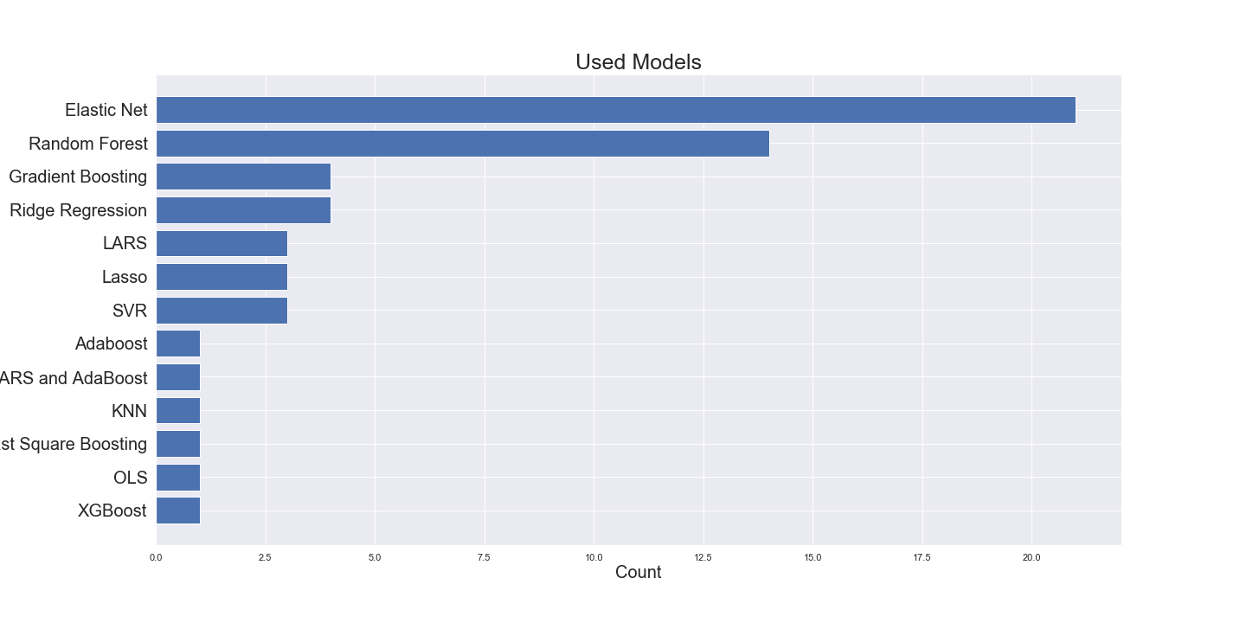
Models Used
Model for smallest actual RMSE
Elastic Net
Model for Closest estimate of actual RMSE
Random Forest

Slide 7
Absolute Distance
place | group | abs distance | place | group | abs distance | place | group | abs distance
1 | s153171 | 0.002383 | 21 | s164529 | 0.593885 | 41 | s183997 | 1.65186
2 | s191685 | 0.0273282 | 22 | s190323 | 0.60886 | 42 | s196622 | 1.71894
3 | s171353 | 0.0370334 | 23 | s174327 | 0.618275 | 43 | s200123 | 1.97105
4 | s152993 | 0.0430298 | 24 | s174434 | 0.628069 | 44 | s164202 | 2.10604
5 | s182332 | 0.0536606 | 25 | s154412 | 0.735058 | 45 | s196542 | 2.18011
6 | s164407 | 0.149537 | 26 | s154675 | 0.743534 | 46 | s192164 | 2.53104
7 | s145129 | 0.209461 | 27 | s144968 | 0.790022 | 47 | s193163 | 2.59187
8 | s151074 | 0.215223 | 28 | s164510 | 0.821689 | 48 | s144278 | 2.6239
9 | s180127 | 0.25727 | 29 | s164180 | 0.83086 | 49 | s153382 | 2.97552
10 | s174309 | 0.257869 | 30 | s060503 | 0.83184 | 50 | s153571 | 3.45322
11 | s192746 | 0.308495 | 31 | s182277 | 0.857333 | 51 | s152991 | 3.49391
12 | s050715 | 0.348997 | 32 | s190191 | 0.898308 | 52 | s164201 | 3.50662
13 | s200118 | 0.360904 | 33 | s192241 | 1.03882 | 53 | s123112 | 3.51715
14 | s960793 | 0.365588 | 34 | s154728 | 1.05514 | 54 | s170279 | 3.63134
15 | s154043 | 0.370126 | 35 | s192309 | 1.06632 | 55 | s192584 | 3.83085
16 | s196693 | 0.380126 | 36 | s175533 | 1.09887 | 56 | s154240 | 5.93346
17 | s134629 | 0.380492 | 37 | s164210 | 1.10754 | 57 | s164143 | 6.34359
18 | s161800 | 0.427101 | 38 | s153178 | 1.19509 | 58 | s164518 | 7.5557
19 | s153986 | 0.479114 | 39 | s154450 | 1.29406
20 | s144731 | 0.558696 | 40 | s193552 | 1.34324

Slide 8
Smallest actual RMSE
place | group | Actual RMSE | place | group | abs distance | place | group | Actual RMSE
1 | s960793 | 1.07741 | 21 | s144968 | 4.3546 | 41 | s152991 | 4.86587
2 | s170279 | 2.82999 | 22 | s174327 | 4.37137 | 42 | s153171 | 4.89762
3 | s164210 | 3.68975 | 23 | s154412 | 4.43042 | 43 | s171353 | 4.90037
4 | s192309 | 3.94785 | 24 | s191685 | 4.43937 | 44 | s161800 | 4.98338
5 | s164180 | 3.97262 | 25 | s192241 | 4.47881 | 45 | s144731 | 5.01938
6 | s153986 | 4.00511 | 26 | s164407 | 4.49362 | 46 | s196622 | 5.0781
7 | s174434 | 4.02465 | 27 | s175533 | 4.49403 | 47 | s050715 | 5.14021
8 | s190191 | 4.03562 | 28 | s180127 | 4.49565 | 48 | s134629 | 5.14021
9 | s154450 | 4.07773 | 29 | s151074 | 4.53678 | 49 | s123112 | 5.43555
10 | s153382 | 4.13912 | 30 | s192746 | 4.56537 | 50 | s182332 | 5.53537
11 | s190323 | 4.15954 | 31 | s164202 | 4.57052 | 51 | s144278 | 5.57824
12 | s164529 | 4.17025 | 32 | s164201 | 4.58796 | 52 | s192164 | 5.78043
13 | s196693 | 4.17444 | 33 | s154675 | 4.59977 | 53 | s154240 | 5.95182
14 | s200123 | 4.17472 | 34 | s060503 | 4.60616 | 54 | s193552 | 6.45107
15 | s153178 | 4.20311 | 35 | s164510 | 4.63483 | 55 | s174309 | 7.35777
16 | s145129 | 4.26834 | 36 | s182277 | 4.65427 | 56 | s193163 | 7.38585
17 | s183997 | 4.28779 | 37 | s192584 | 4.73685 | 57 | s164143 | 7.77383
18 | s153571 | 4.30917 | 38 | s154043 | 4.77133 | 58 | s164518 | 12.202
19 | s200118 | 4.3315 | 39 | s154728 | 4.83315
20 | s196542 | 4.33678 | 40 | s152993 | 4.86012

